Slide 1
Vehicle-to-Grid Reactive Power Operation Using Plug-In Electric Vehicle Bidirectional Off-Board Charger
PRATINAV KASHYAP(17BEE1048)
LAL VARUN MUKESH(17BEE1001)
RUSHALI GHOSH(17BEE1162)

Slide 2
OBJECTIVE
Simulation of Plug-In Electric Vehicle Bidirectional Off-Board Charger
Vehicle to grid reactive power operation simulation.
Reduced THD of the input side
Design a control system to fulfill above objectives which would provide a good steady state performance and a fast dynamic response whenever required.

Slide 3
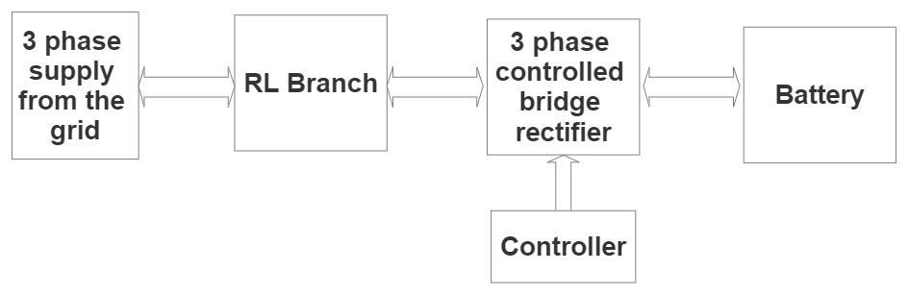
BLOCK DIAGRAM

Slide 4
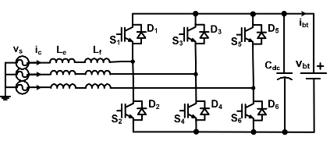
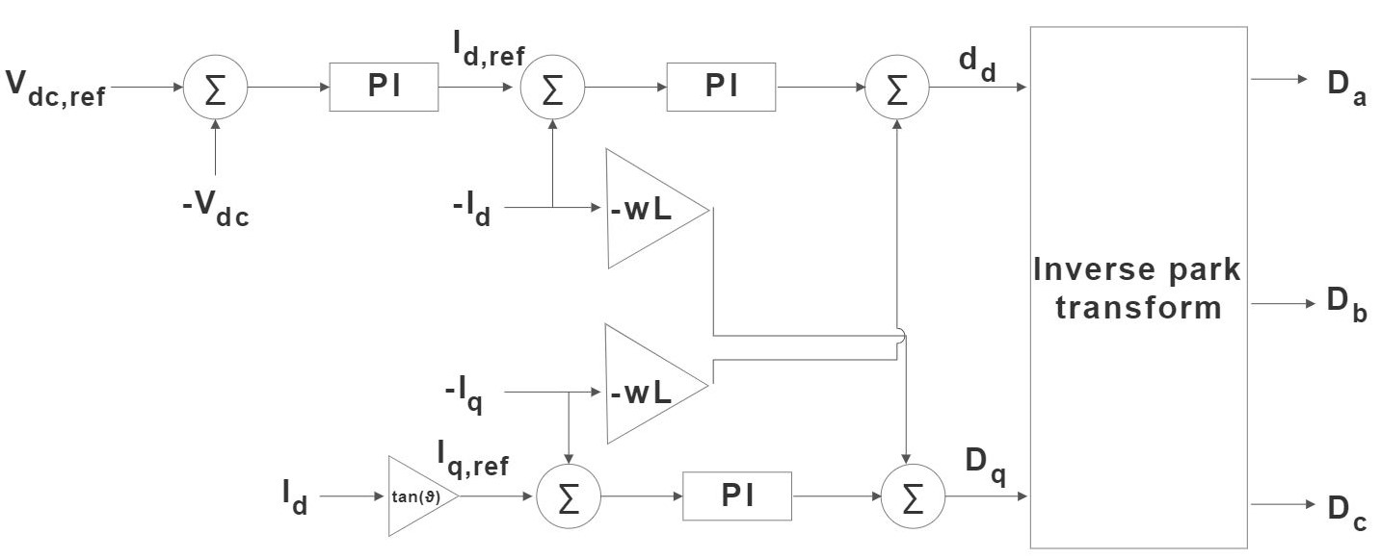
CIRCUIT DIAGRAM
Configuration of the off-board fast charger ac-dc converter
Proposed controller of off-board bidirectional
PEV charger

Slide 5
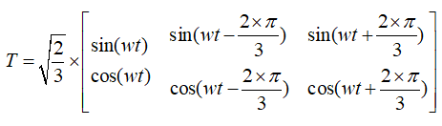
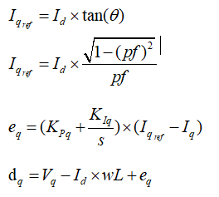
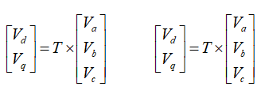
CIRCUIT CALCULATIONS
Park transformation matrix is used to get d-q components,
Control of reactive power using power factor control:
Supply voltage and current in d-q frame,

Slide 6
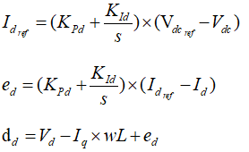
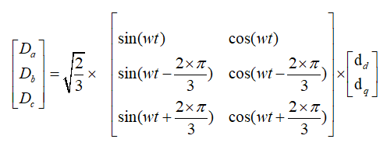
Control of Voltage output using Voltage control:
INVERSE PARK TRANSFORMATION:

Slide 7
DESIGN SPECIFICATIONS
1 | Ac frequency | 50 Hz
2 | AC Phase-to-phase voltage (Vrms) | 220*sqrt(3)
3 | Series resistance | 1 ohm
4 | Series Inductance (L) | 1 mH
5 | DC link Capacitance (C) | 4700 uF
6 | Load resistance | 100 ohms
7 | Load source voltage (battery voltage) | 750V
8 | Reference DC Voltage | 650V
9 | Reference Power factor | 0.8
10 | Load | 2.1kW (@normal load), 4.5kW (@increased load), -1kW (@load as source)

Slide 8
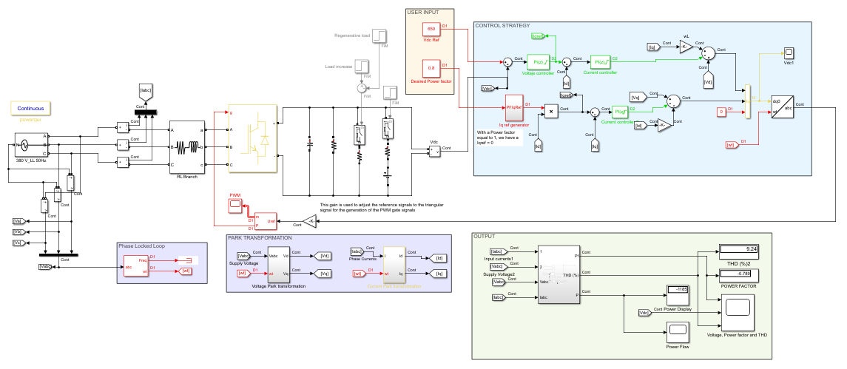
Simulation

Slide 9
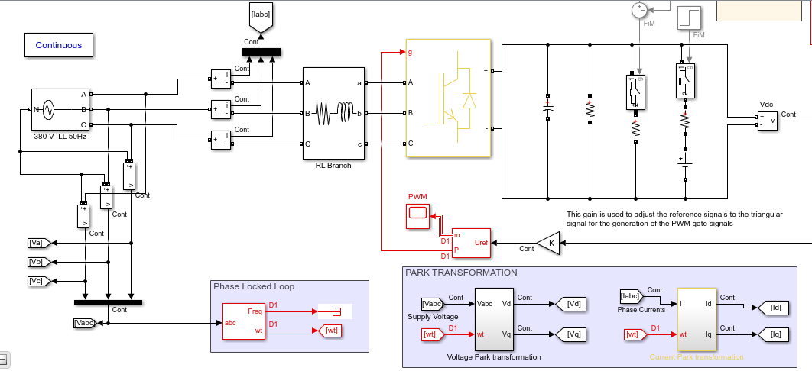
The Three Bridge Universal Converter, PLL block and Park transform block:

Slide 10
LOAD SIMULATION (Battery pack)
To simulate different conditions we have taken 4 instances:
A normal 2.1kW load (0s to 1s)
Load increases to 4.5kW (1s to 2s)
load reduces to 2.1kW (2s to 3s)
The load starts delivering 1kW power to the grid (3s to 4s)

Slide 11
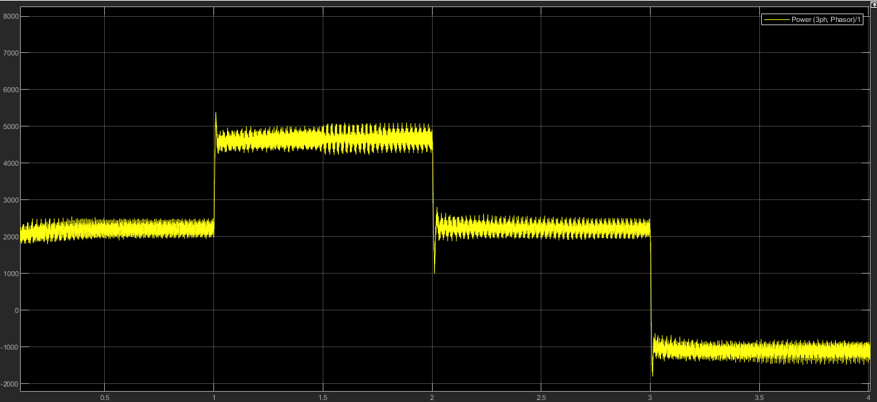
Power flow Waveform

Slide 12
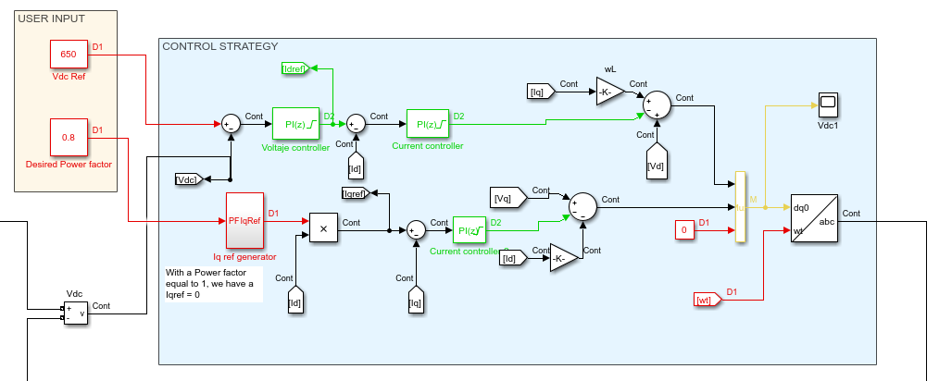
Control Stratergy and User Input

Slide 13
OUTPUT WAVEFORMS
The input power factor is controlled at 0.8 and after 3 seconds as the load turns into the source the power factor becomes negative 0.8 which means that the power flows from the battery to the grid.
The second graph is the rectified output. The controlled 650V output is consistent throughout.
The final graph shows the THD of the input current. The THD at steady state is under 5%.

Slide 14
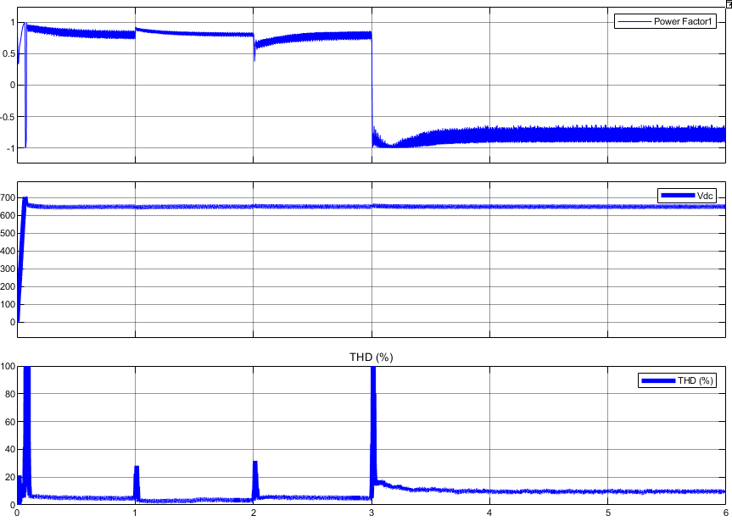
Output Waveforms

Slide 15
CONCLUSION
Simulation of Plug-In Electric Vehicle Bidirectional Off-Board Charger has been completed.
The desired control of power factor was achieved
The Voltage control was achieved
The THD is under 5% for normal load and under 10% for load as a source.
The dymanic response of the converter is also good and is verified by change in load.

Slide 16
REFERENCES
M. Kesler, M. C. Kisacikoglu and L. M. Tolbert, "Vehicle-to-Grid Reactive Power Operation Using Plug-In Electric Vehicle Bidirectional Offboard Charger," in IEEE Transactions on Industrial Electronics, vol. 61, no. 12, pp. 6778-6784, Dec. 2014, doi: 10.1109/TIE.2014.2314065

Slide 17
THANK YOU

